Slide 1

Fingerprint Bike Starter
Name :- Shubham SHARMA, Vaishali Bharti
Enrollment no. :- 12002040501071, 12002040501076
Guided by :- Prof. Namrata Dave
College :- G. h. Patel college of engineering and technology

Slide 2
Table of Content
Objective
Introduction
Literature Survey
Algorithm
Model Demonstration
How it Works?
Interfacing
Implementation
Block Diagram
Components
Pin Diagram of Arduino NANO
Flow chart
Results
Conclusion
References

Slide 3
Objective
The objective of a fingerprint bike starter is to provide a secure and convenient way for motorcycle riders to start their bikes. Instead of using a traditional key, the rider uses their unique fingerprint to unlock and start the motorcycle. This can prevent unauthorized access to the bike, as only those with a registered fingerprint can start it. Additionally, it can eliminate the need to carry a physical key, which can be lost or stolen, and can provide a faster and more convenient way to start the bike.

Slide 4
Introduction
A fingerprint bike starter is a high-tech device that allows a motorcycle owner to start their bike without a key. Instead of using a physical key, the system is equipped with a biometric scanner that reads the owner's fingerprint and uses it to activate the ignition. This technology not only provides convenience, but it also enhances the security of the motorcycle since only authorized users with registered fingerprints can start the engine. Fingerprint bike starters are becoming increasingly popular among motorcycle enthusiasts and are considered a reliable and advanced alternative to traditional key-based ignition systems.

Slide 5
Literature Survey
"Development of a Fingerprint Recognition System for Motorcycle Ignition Security" by J.S. Kim et al. (2015) - This study proposed a fingerprint recognition system for motorcycle ignition security. The authors designed a fingerprint scanner that can be installed on the motorcycle handlebar, and a microcontroller that processes the data and performs the necessary authentication checks. The system was tested using a database of fingerprints, and the results showed a high level of accuracy and security.
"Design and Implementation of a Fingerprint-Based Motorcycle Ignition System" by T.I. Jimoh et al. (2019) - This study aimed to develop a fingerprint-based motorcycle ignition system that is easy to use and provides a high level of security. The authors designed a system that uses a fingerprint scanner and a microcontroller to control the ignition. The system was tested using a database of fingerprints, and the results showed that it is a reliable and secure system for motorcycle ignition.
"A Review of Fingerprint Recognition Techniques" by P.K. Kisku et al. (2018) - This review article provides an overview of fingerprint recognition techniques, including the various types of sensors and algorithms used in fingerprint recognition systems. The article highlights the importance of fingerprint recognition in various applications, including access control and authentication.

Slide 6
Algorithm
The algorithm for a fingerprint bike starter involves several steps:
Initialization
Fingerprint Scanning
Feature Extraction
Authentication
Engine Start
Error Handling
Overall, the algorithm ensures that only authorized users with registered fingerprints can start the motorcycle's engine, providing a secure and convenient way of starting a motorcycle.

Slide 7
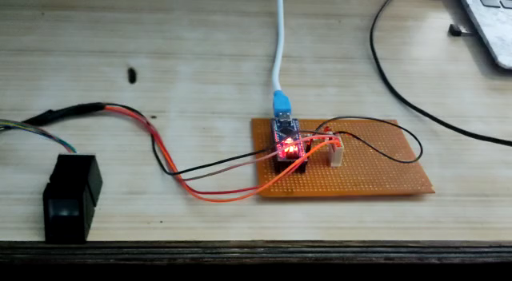
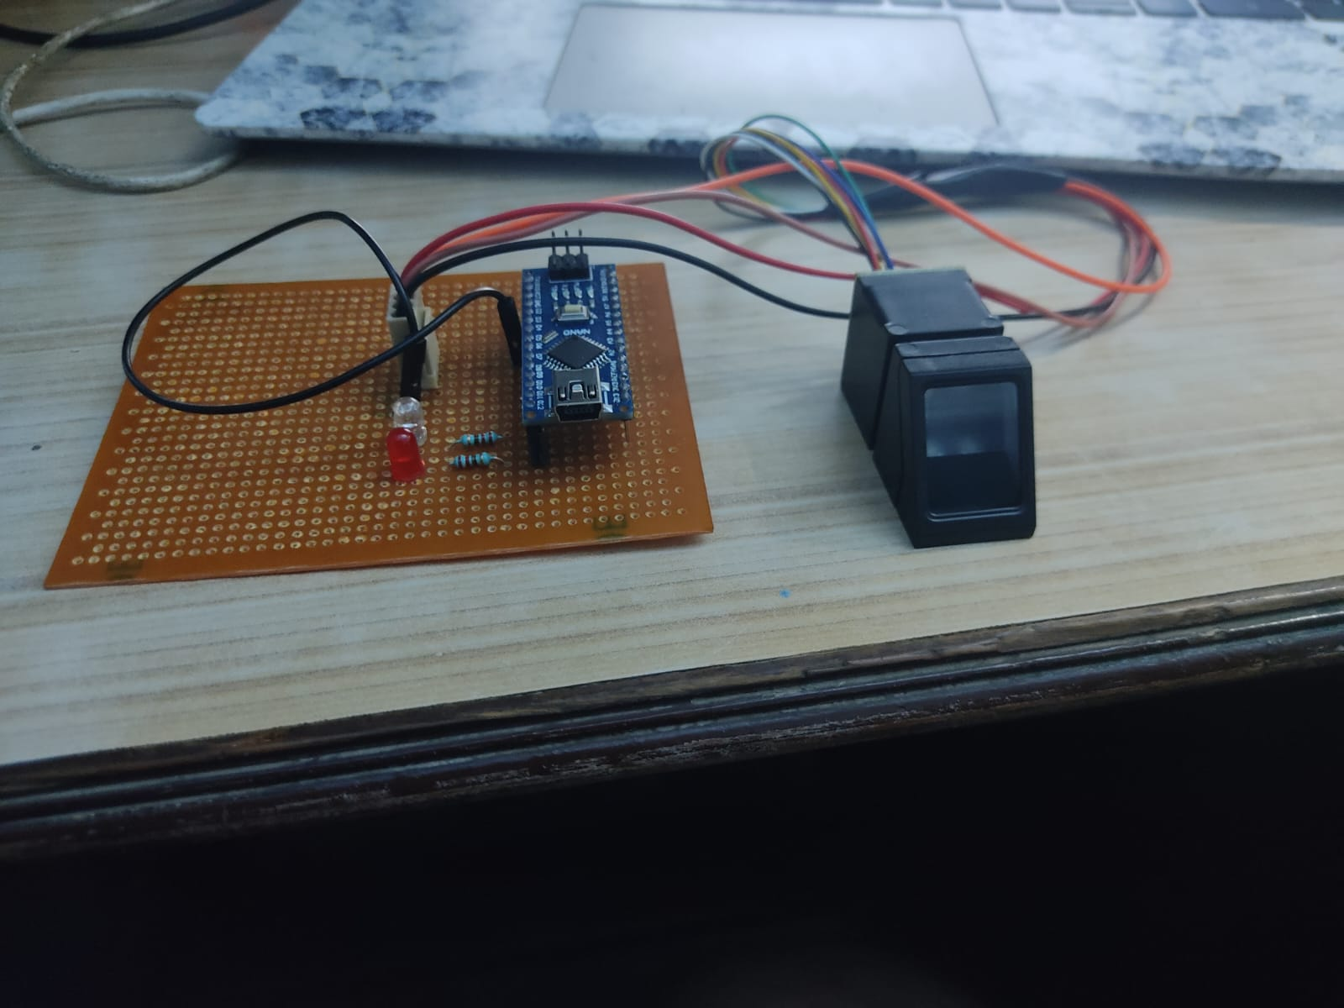
Model Demonstration
Model Video
Model Image

Slide 8
How It Works?
A fingerprint bike starter can be implemented using an Arduino Nano, which is a compact and easy-to-use microcontroller board. Here's how a fingerprint bike starter can work with Arduino Nano:
Hardware Setup
Fingerprint Scanning
Feature Extraction
Authentication
Engine Start
Error Handling
Overall, a fingerprint bike starter with Arduino Nano provides a secure and reliable way to start a motorcycle, ensuring that only authorized users with registered fingerprints can activate the ignition system.

Slide 9
Interfacing
The interfacing of a fingerprint bike starter involves connecting the components of the system to each other and to the motorcycle's ignition system. Here are the steps for interfacing a fingerprint bike starter:
Biometric Scanner
Arduino NANO
Power Supply
Fingerprint Database
Programming
Testing
Overall, interfacing a fingerprint bike starter involves connecting the components, storing the fingerprint features, programming the microcontroller board, and testing the system to ensure it works correctly.

Slide 10
Implementation
Implementing a fingerprint bike starter using Arduino Nano involves the following steps:
Hardware Setup
Install Libraries
Fingerprint Scanning
Fingerprint Database
Authentication
Engine Start
Error Handling
Overall, implementing a fingerprint bike starter using Arduino Nano involves connecting the hardware components, installing the required libraries, programming the microcontroller board, and testing the system to ensure it works correctly.

Slide 11
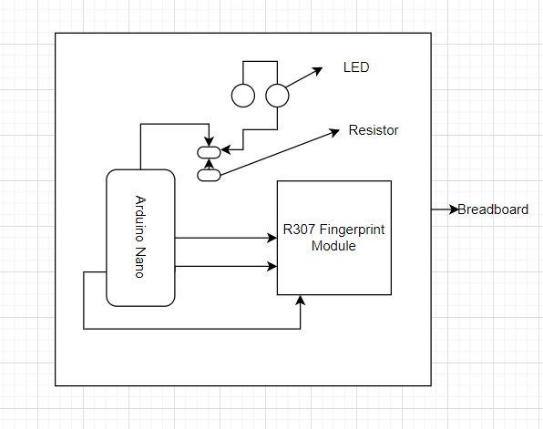
Block Diagram

Slide 12
Components
Hardware Required
Software Required
Arduino NANO
R307 Fingerprint Sensor
L.E.D
Resister
Breadboard
Connecting Wires
Arduino IDE(Desktop Software)
Adafruit Fingerprint Library
Fingerprint_scanner-ttl-master library

Slide 13
Arduino NANO
Arduino Nano is a compact and affordable microcontroller board based on the ATmega328P microcontroller. It is a popular choice among hobbyists and makers for prototyping and creating various projects. The Arduino Nano board is similar to the Arduino Uno board in terms of functionality but is smaller in size and has a different form factor.
The Arduino Nano board has the following specifications:
Microcontroller: ATmega328P
Operating Voltage: 5V
Input Voltage: 7-12V
Digital I/O Pins: 14 (6 of which are PWM)
Analog Input Pins: 8
Flash Memory: 32 KB (of which 2 KB is used by the bootloader)
SRAM: 2 KB
Clock Speed: 16 MHz

Slide 14
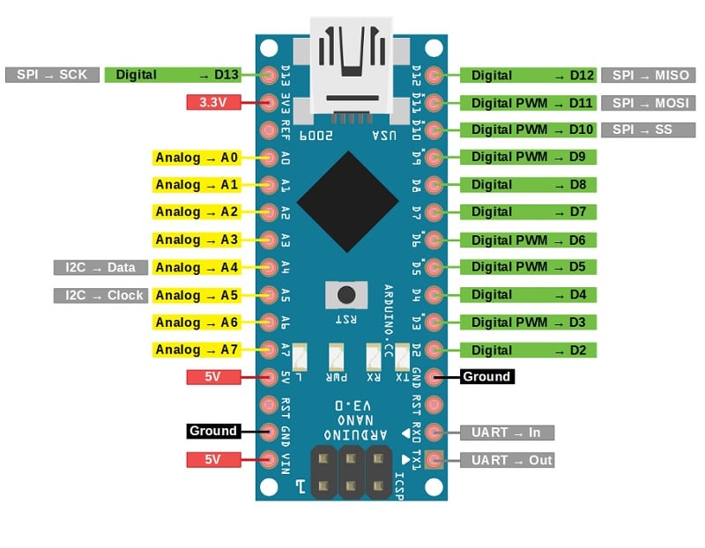
Pin Diagram of Arduino NANO

Slide 15
R307 Fingerprint Sensor
The R307 fingerprint sensor is a small module that can capture and store fingerprints for use in biometric authentication systems. It uses optical technology to scan a user's fingerprint and convert it into a digital template that can be compared against stored templates to verify the user's identity.
The R307 fingerprint sensor module includes an onboard microcontroller and can communicate with external devices over UART or USB. It has a high resolution of 500dpi and can store up to 1000 fingerprint templates in its internal memory.
The R307 fingerprint sensor can be used in a wide range of applications, such as access control, time and attendance systems, and identification verification. It is easy to integrate into existing systems and can provide a reliable and secure method of biometric authentication.

Slide 16
Resistor
A resistor is an electronic component that is designed to resist the flow of electric current through a circuit. It is typically made of a material that has a high resistance to current flow, such as carbon or metal.
The resistance of a resistor is measured in ohms (Ω) and is determined by the physical properties of the resistor, such as its length, diameter, and material. Resistors come in a wide range of values, from less than one ohm to millions of ohms, and are typically color-coded to indicate their value.
Resistors can come in different physical configurations, including through-hole resistors, which have wire leads that can be inserted into a circuit board, and surface mount resistors, which are mounted directly onto a circuit board. They are a fundamental component in almost all electronic circuits and are widely used in applications ranging from simple LED circuits to complex computer systems.

Slide 17
Breadboard
A breadboard is a device used to prototype and test electronic circuits. It allows electronic components to be easily connected together without the need for soldering or permanent wiring.
Breadboards typically consist of a plastic board with a series of metal clips or sockets arranged in a grid pattern. These clips or sockets provide a means of connecting electronic components, such as resistors, capacitors, and integrated circuits, together in a temporary manner.
The clips or sockets on a breadboard are arranged in rows and columns, with each row and column connected internally. This allows components to be connected together by simply inserting their leads or pins into adjacent clips or sockets.

Slide 18
Adafruit Fingerprint Library
The Adafruit fingerprint library is an open-source software library that allows developers to easily interface with fingerprint sensors from Adafruit, such as the GT-521F32 and GT-521F52. The library provides a set of functions for enrolling, verifying, and deleting fingerprint templates, as well as configuring the sensor settings.
The Adafruit fingerprint library supports several communication protocols, including UART, I2C, and SPI, and can be used with a variety of microcontrollers and development boards, such as Arduino and Raspberry Pi. The library is designed to be easy to use, with a simple and intuitive API that abstracts away the low-level details of communicating with the fingerprint sensor.
In addition to the core functionality for interacting with fingerprint sensors, the Adafruit fingerprint library also includes several example sketches that demonstrate how to use the library in various applications. These examples include a basic fingerprint scanner, a door lock that uses fingerprint authentication, and a project that sends fingerprint data to a server for remote authentication.

Slide 19
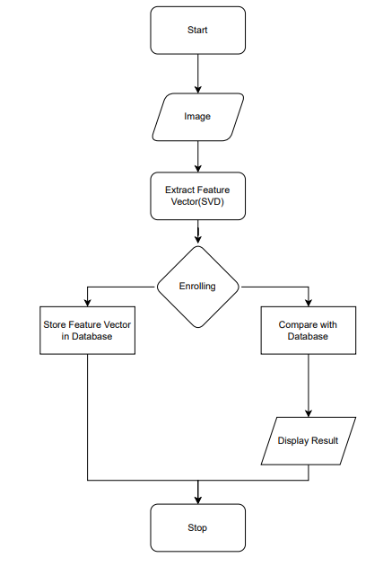
Flow Chart
Start
Authenticate fingerprint
Check if fingerprint matches stored fingerprints
If match found, unlock the ignition
Ask user to turn on the ignition
If ignition is turned on, start the bike
End

Slide 20
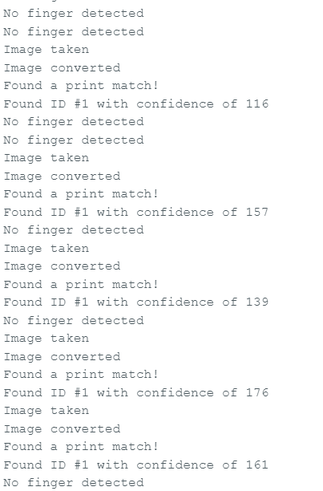
Result
As the result our project gives an accuracy Rate of 100 – 200 every time you use it.

Slide 21
Conclusion
In conclusion, using a fingerprint sensor as a bike starter can be a secure and convenient way to start a bike without the need for keys or buttons. The use of biometric identification such as fingerprints can provide an additional layer of security to prevent unauthorized access to the bike.
However, it is important to consider the reliability and safety of the system when implementing a fingerprint bike starter. The system should be designed and tested thoroughly to ensure that it is both reliable and secure. Any vulnerabilities or malfunctions in the system could potentially result in unauthorized access or dangerous situations while operating the bike.
Overall, a fingerprint bike starter can be an interesting and useful application of fingerprint technology, but it requires careful consideration and planning to ensure a safe and reliable implementation.

Slide 22
References
"Design and Implementation of Fingerprint Based Bike Ignition System" by O. Adeniran and O. T. Ojo. International Journal of Advanced Research in Computer Science and Software Engineering, vol. 7, no. 4, April 2017.
"Design and Implementation of Fingerprint-Based Bike Ignition System Using GSM Technology" by B. V. Kalyani and K. Ravi Kumar. International Journal of Innovative Research in Computer and Communication Engineering, vol. 4, no. 5, May 2016.
"Development of Fingerprint Biometric Ignition System for Motorcycles" by M. A. Zainal Abidin and N. H. M. Nor. Journal of Telecommunication, Electronic and Computer Engineering, vol. 9, no. 1-2, 2017.

